Slide 1
Class 13-Object Oriented Programming

Slide 2
What is a CLASS?
Class(Vehicle) is blueprint of a Object
It is a design designated to given object(car,auto,cycle,truck)
It describes the attributes/properties and functions of the object.
In order to define a an object we first need to make a class.
Object is considered to be a instance of a class.
Objects helps system to interact with real-life objects, know their properties and functions and with them.

Slide 3
Vehicle(class)
Properties:
Number tyres, colors, number doors, model, no.of passenges, size
Functions:
Breaks
accelerate
State= [straight, back, right, left, halt]

Slide 4
CLASS ‘Vehicle’ object = Cycle
Vehicle{
Tyre count,
color,
door count,
model,
passenger,
size
mileage
// Functions
brakes();
accelerate();
taking_turn(state);
}

Slide 5
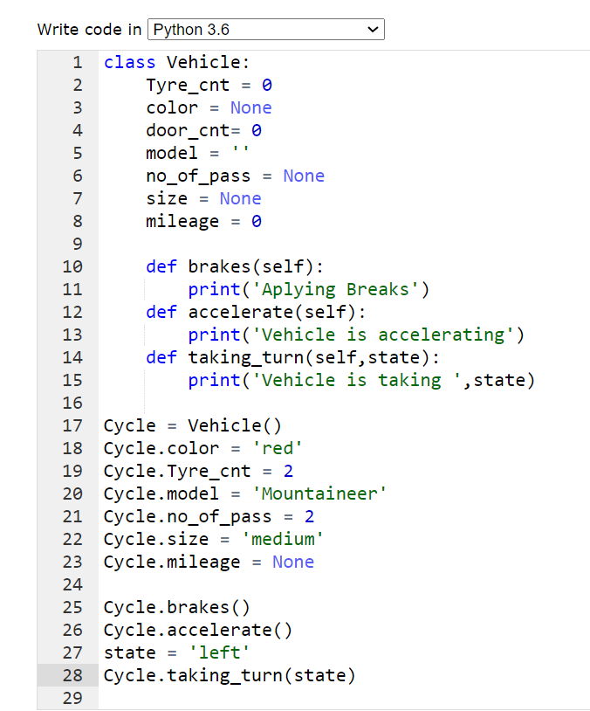

Slide 6
CLASS ‘Person’ object=A , B
Properties/attributes:
Height
Weight
Gender
Action/Functions
Eating()
Dancing()
Playing()
Sleeping()

Slide 7
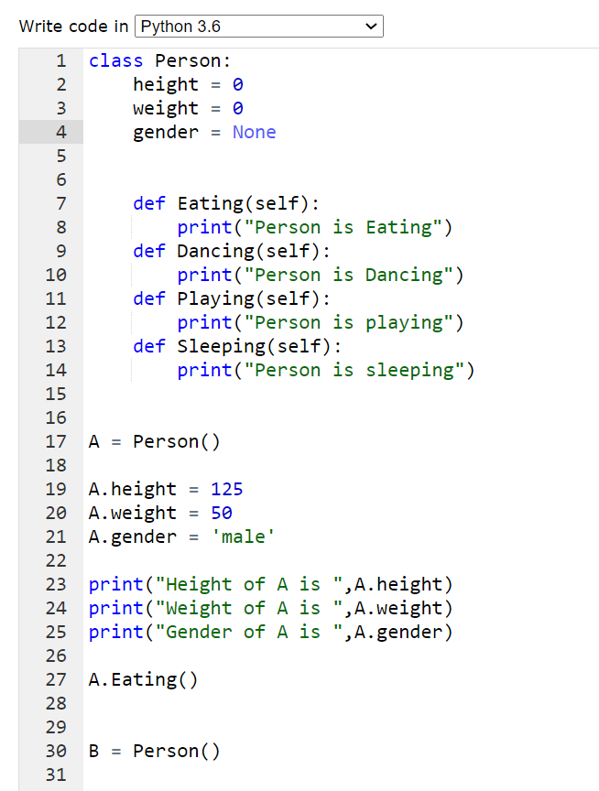

Slide 8
Classes dealing with functions.
Class Student{
Name
Age
Phone Number
Course_enrolled
//Functions
Reading(books) // prints what book object is reading.
Studies() // prints what is he/she is studying
AllDetails()// prints all the details of the object.
}

Slide 9
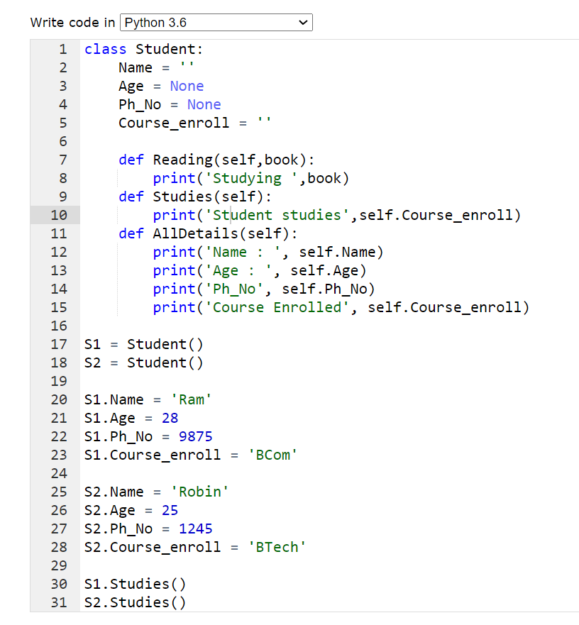

Slide 10
Using Constructors
Constructors are used to initialise initialise the data objects with initial values.
For this we use __init__ method for initialising values which acts as a constructors.
Example: Constructor for Student Class
def __init__(self,Name=‘’,Age=None,PhNo=None,C_enroll=‘’):
self.Name = Name
self.Age = Age
self.Ph_No = PhNo
self.Course_enroll = C_enroll

Slide 11
Creating Objects using Constructors
Constructor is always invoked when we create a object.
Consider Constructor created in previous slide.
We will create object S1 having some initial values.
S1 = Student(‘Ram’,29,112233,’BSc’)
S2 = Student()
Here we can see object S1 will be having Name as Ram, Age as 29, Phone Number as 112233 and Course Enrol as BSc.
Object S2 would not be having any such values because no values were given when the object was created. Therefore it would be having default values in them.

